Slide 1
Week 9 Assignment
Introduction to Node

Slide 2

Server Side Programming
Previously, we have written code that is served to the user and run in the browser. Javascript listens for user behavior and executes code that manipulates the DOM as a result.
Server side programs are never given to users. They run constantly on the server, waiting for requests the same way JS listens for events. They will then run code and provide a response back to the client.

Slide 3
Node.js
We will be using Node to run Javascript as server side code. Using modules like Express, we will be making forward-facing APIs like the ones you have been using with AJAX fetch.
We will define API endpoints, and then provide the code that should be run if someone requests from that endpoint. In doing so, we can read their query parameters and respond with relevant data.
It is now absolutely critical that you have Node properly installed.

Slide 4
Basic app.js structure
'use strict';
const express = require('express');
const app = express();
// define all endpoints here
app.use(express.static('public'));
const PORT = process.env.PORT || 8000;
app.listen(PORT);

Slide 5
Our first endpoint
app.get('/hello', function (req, res) {
res.type('text');
res.send('Hello World!');
});
app.get(...) | Method to handle GET requests
app.post(...) | Method to handle POST requests
req | Request object, holds items like the request parameters
res | Response object, has methods to send data to the client
res.type(...) | Sets the "content-type". Always set either "text" or "json" with your response
res.send(response) | Sends the response to the client
res.json(response) | Does the same as res.send, but with a JSON object

Slide 6
Setting up the project and running the server
Assuming your project has the correct directory structure, run the command npm init at the root
You will need to install any non-core modules using npm. Run the command npm install <package-name> to do so.
Open a terminal in the directory with the server and enter nodemon. nodemon is a tool that restarts the server if you make changes to the JS code in order to reflect the changes.
To stop the server, enter ctrl+c in the terminal.
Access your page in the browser. Since the server is being hosted locally on your machine, use the URL localhost:8000/hello. 8000 is the port we specified in hello.js.
Since we told the server to serve files in the "public" directory, we can access our website with the url localhost:8000/hello.html.

Slide 7
Route parameters
You may recognize this from the number trivia API we used at the beginning of AJAX. We can accept parameters directly inside of the URL with node.JS by putting them in the endpoint we pass into app.get:
Node.JS: app.get('/hello/name/:first/:last', ...)
Request: localhost:8000/hello/name/dwayne/johnson
The colon before the param name implies that it is a key, whose value is passed in by the user when they make the request. In your code, you can access these parameters in a similar way to query parameters:
Node.JS: let firstName = req.params['first'];
You do not need to check that these are defined, because in order for them to use this endpoint, they must have the parameters.

Slide 8
Query Parameters
In Node.JS, we can access user supplied GET parameters as follows:
Request: localhost:8000/hello?key=value
Node.JS: let value = req.query['key']
It is important, though, to make sure that the user actually supplied the parameter, since we will get undefined otherwise. Always check if parameters are defined before accessing them
Node.JS: if (req.query['key']) { ... }

Slide 9
Setting Error Codes
In the case that you encounter an error, you'll want to send a request with an error code. If you just send a regular response, it will not cause checkStatus to fail, nor will it communicate that it is an error
Remember to always set the type of the response - even when handling errors
We can use the status method of the response object to set the code.
res.type('text').status(400).send('Error, Bad Request!');

Slide 10
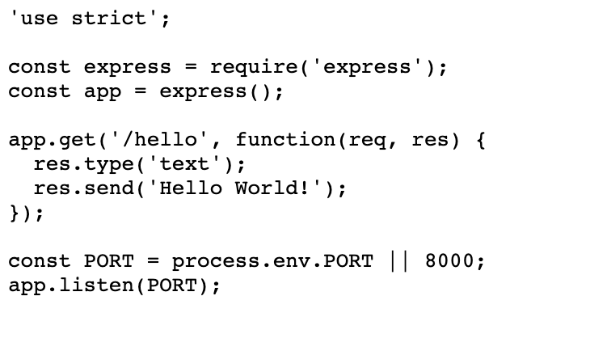
Example endpoint

Slide 11
Exercise 1: Splendid Circles
Add a new GET endpoint, /math/circle/:r, which takes a radius as a URL parameter. It should then respond in JSON with the area and circumference.
{"area": 3.14, "circumference": 6.28}
The area of a circle is PI * r * r, and the circumference is equal to PI * 2r. You can access PI with Math.PI.

Slide 12
app.js -- copy this file and add to it for your exercises
'use strict';
const express = require('express');
const app = express();
// define endpoint for exercise 1 here
// define endpoint for exercise 2 here
const PORT = process.env.PORT || 8000;
app.listen(PORT);

Slide 13
Exercise 2: Hello, you!
Add a new GET endpoint, /hello/name, which takes as query parameters a first and last parameter. It should then respond in plain text with "Hello firstName lastName" replacing firstName with the value of first and lastName with the value of last
If they fail to provide the necessary GET parameters, respond with a 400 status code, and the error message "Missing Required GET parameters: first, last". If they provide one, but not the other, your error message should only have the missing parameter listed.

Slide 14
Turn in your app.js

